Slide 1

License plate recognition
COS30018
Group 2

Slide 2
Content
Introduction
The initial solution
Improvements
References

Slide 3
License plate recognition
License Plate Recognition (LPR) is a technology to read vehicle registration plates. It enables the automatic identification and tracking of vehicles by capturing their license plate information from images or video sequences.
LPR can be used in fields such as:
Law enforcement
Toll collection
Parking management
Traffic monitoring

Slide 4
Steps of Plate recognition
Image Capture: High-speed cameras capture images of vehicles.
Image Preprocessing: Image enhancement and noise reduction.
Detection:
License Plate Detection: Identifying the license plate within the image.
Character Segmentation/ Detection: Isolating individual characters on the plate.
Optical Character Recognition (OCR): Converting images of characters to text.
Data Analysis: Cross-referencing with databases for information retrieval.Detect and localize a license plate in an input image/frame

Slide 5
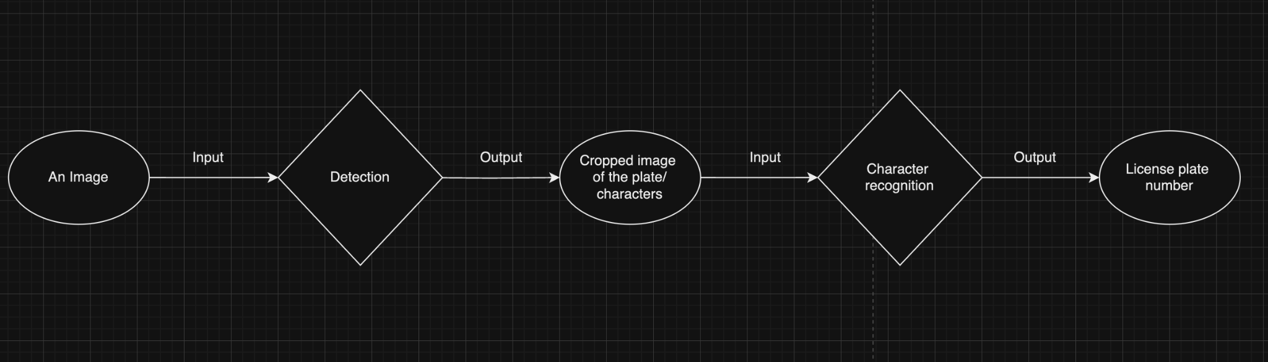
Input and output

Slide 6
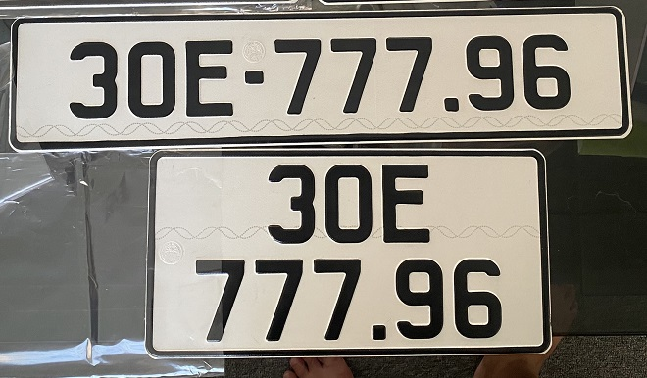
License plate detection
There are 2 types of license plate that we would like to detect
1 line plate
2 lines plate

Slide 7
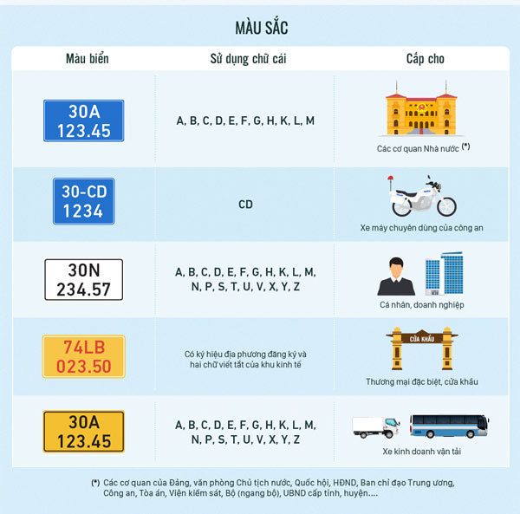
Character recognition
According to the Vietnamese license plate rules, the characters will be classified into 32 classes:
20 letters: A, B, C, D, E, F, G, H, K, L, M, N, P, S, T, U, V, X, Y, Z
10 numbers: 1,2,3,4,5,6,7,8,9,0
2 special characters: -, .

Slide 8
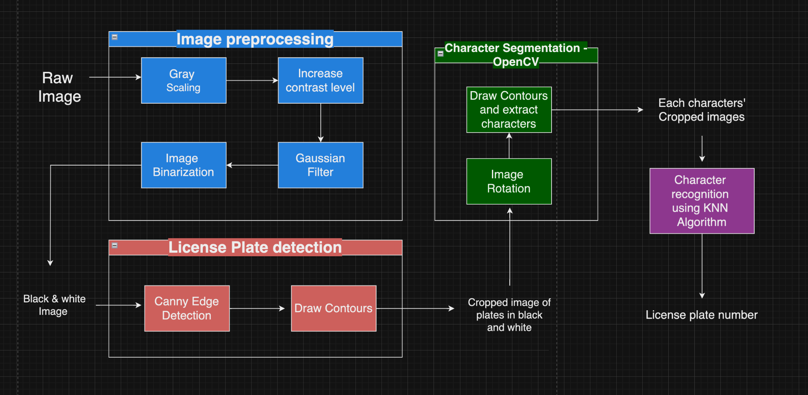
Initial Solution

Slide 9
Image preprocessing
There are 4 main stages in preprocessing the image
Gray scaling
Increasing the contrast level
Noise Decreasing by Gaussian filter
Adaptive threshold for image binarization

Slide 10
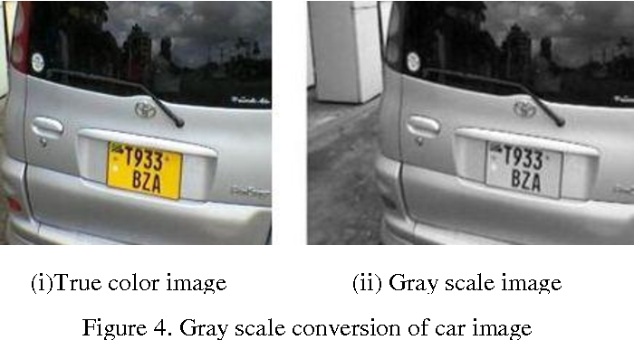


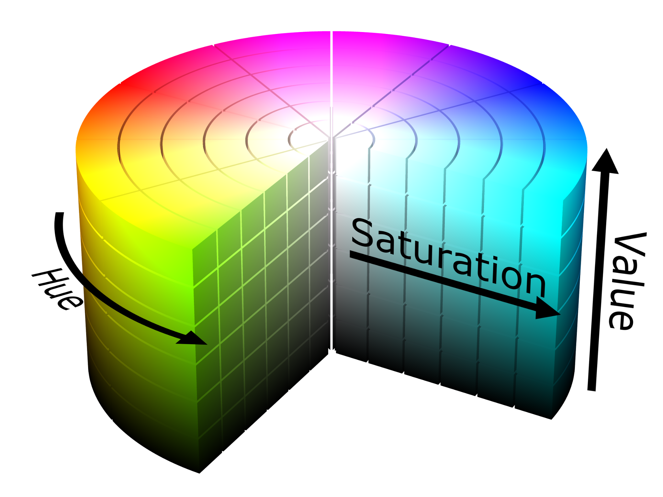
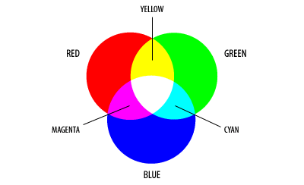
1. Gray Scaling
The purpose of gray scaling is to tame the complexity of the image and make it compatible to other algorithms (Canny). Gray scaling convert images displayed in color scales such as RGB, CMYK, HSV into shade of gray color. This reduce the initial's image dimensions (3 or 4) to only 1 dimensions

Slide 11
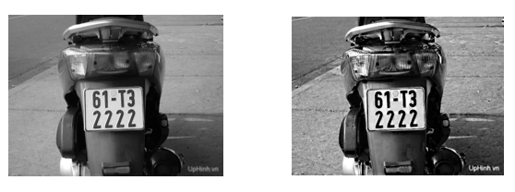
2. Maximize contrast
We dilate the details in the image so that the black elements become darker and the bright elements become even brighter.
This increase the separation between the numbers and the background in a plate.
Before | After

Slide 12
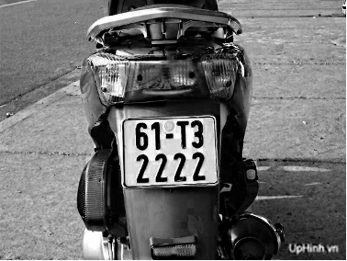
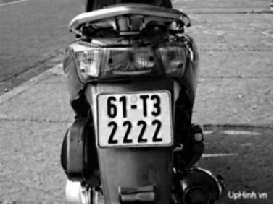
3. Gauss filter
Before | After
The Gauss filter is used to reduce noise and make the surroundings blurr, therefore focusing on the central point.

Slide 13
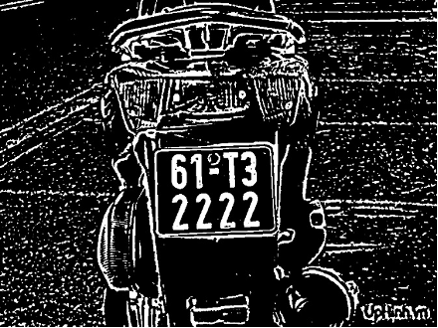
4. Image Binarization
Converting a gray-scaled image into a binary image, which only contain 0(black) and 1(white)
Parameters:
M(x,y): Intensity of position x,y on gray scaled
T: a adaptive threshold - generated with openCV
MB(x,y): Intensity at position x,y on binary image
Conversion:
M(x,y) >= T => MB = 0
M(x, y) < T => MB = 1

Slide 14
License Plate detection
There are 2 main stages in detecting and extracting the license plate
Canny Edge detection
Detect the plate by drawing contours and if..else

Slide 15
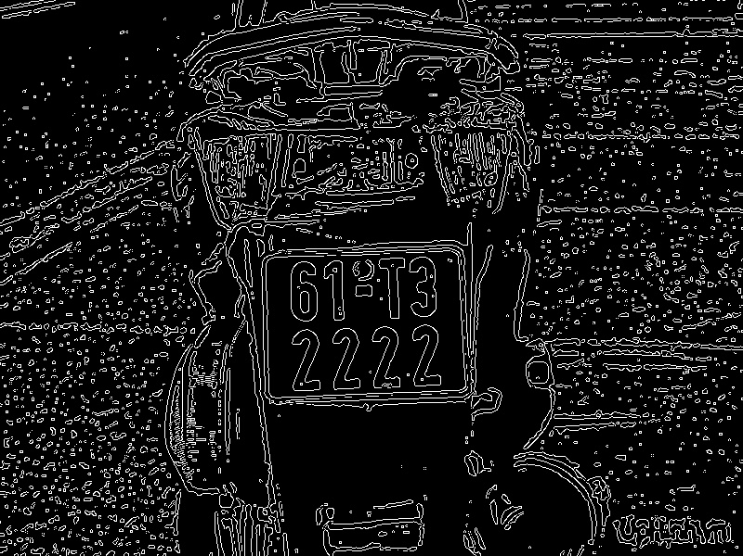
1. Canny edge detection
Use 3x3 filters applied to each pixel of the image to indicate their gradient: G = √(Gx^2 + Gy^2)
We compare the central pixel with its neigbour pixels in 3 directions:
0 degree angle: horizontal
90 degree angle: vertical
45 degree angle: diagonal
We will only keep its gradient if it is the highest value in the neighbourhood, else we will set it gradient to 0, which represent black

Slide 16
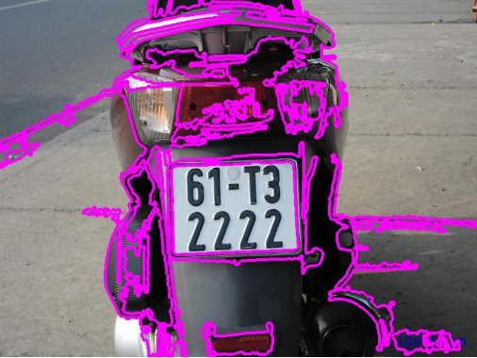
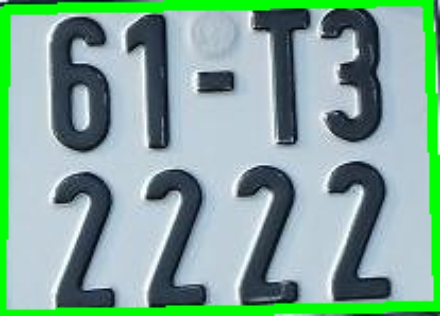
2. Drawing contour - openCV
Using suzuki’s tracing algorithm in OpenCV library. The agent will start from the most bottom left pixel and changes direction according to the color of the pixel it moves into (0 or 255)
The routes that looks like a 4 sides polygon will be identified as licenses and stored using the (x,y) coordinates of the

Slide 17
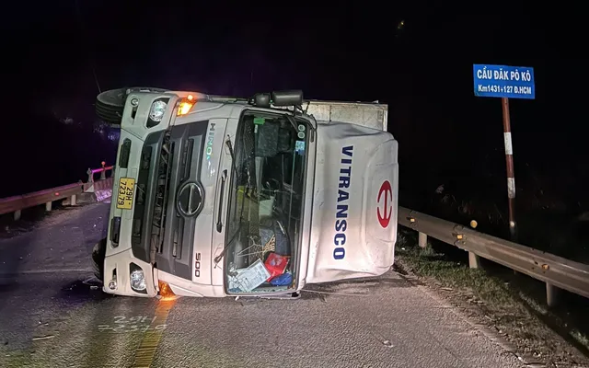
Character segmentation
Can you guys see what’s wrong with these image ?

Slide 18
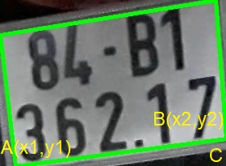
Rotate the image to the right orientation
Filter out the coordinates of 2 vertices A, B of the drawn contour located at the bottom of the number plate
With A(x1, y1) and B(x2,y2), we can calculate the rotation angle using tan((y2-y1)/(x2 - x1)) function
Rotate the image according to the calculated rotation angle.
A lower than B: tan() is positive => rotate clockwise
A higher than B: tan() is negative => rotate anticlockwise

Slide 19
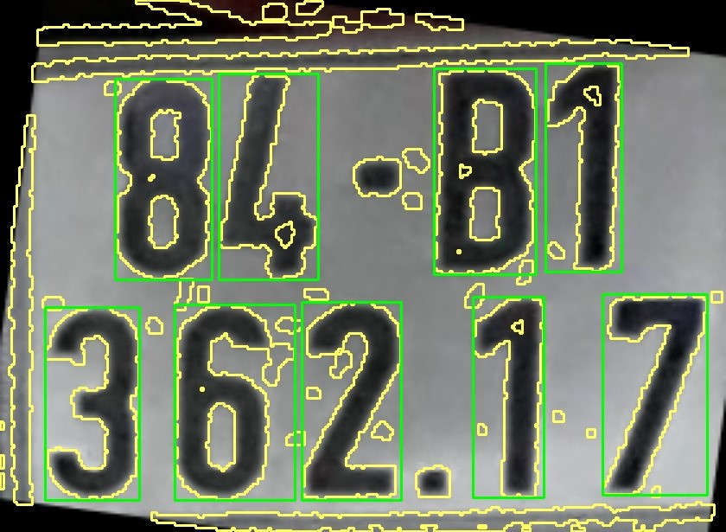
Drawing the contour for the letters
The contour for the letters is reconstructed from the binary picture (the white part). Then, around those characters, draw rectangles. However, locating this contour is difficult, resulting in inaccurate outcome and the discovery of non-character objects. We'll use the height/width ratio of the character, as well as the character's area in comparison to the number plate.

Slide 20
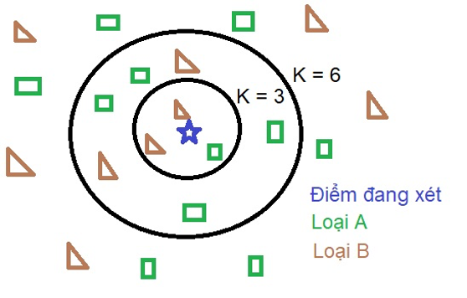
Character recognition using K nearest neighbor
KNN is one of the simplest supervised learning algorithms in Machine Learning, operating in a 4-step process:
Determine the parameter K (number of nearest neighbors).
Calculate the distance from the point in question to all points in the given data set
Sort those distances in ascending order
Considering in the set K the closest point to the point under consideration, if the number of points of any kind is higher, it is considered that the point under consideration belongs to that type.

Slide 21
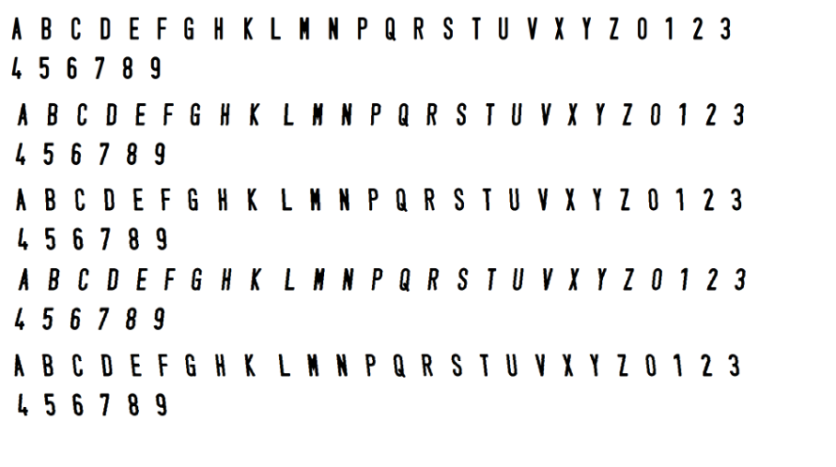
Character recognition using K nearest neighbor (next)
Normalization: Because each letter is variable in size, the processing is more difficult, thus the picture must be normalized with a height: width ratio of 30:20 pixels.
Our labeled points include the characters that could appear in a license plate, with rotation angle of 1-10 degree
Next, we perform the input of the image we are considering and calculate the distances to all points in the sample, the result will be the ASCII code representing that image. Finally, we print out the license plate number.

Slide 22
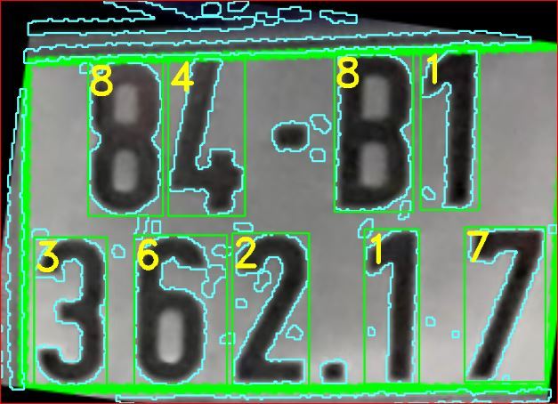
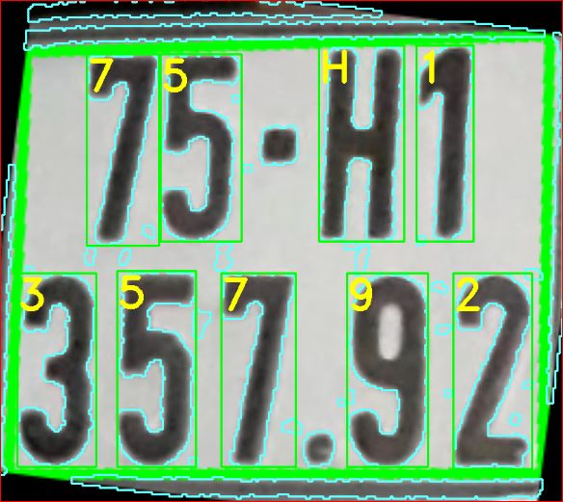
Character recognition using K nearest neighbor (next)

Slide 23
Problems with the initial solution
Plate detection is not optimized (in cases where plates have drawings, decorations,..)
The recognition ability of KNN method is quite low, a lot of times classify the character incorrectly.
The runtime is long as it has to scan through all the training data.
It performs poorly in case of light, reflection, blurriness

Slide 24
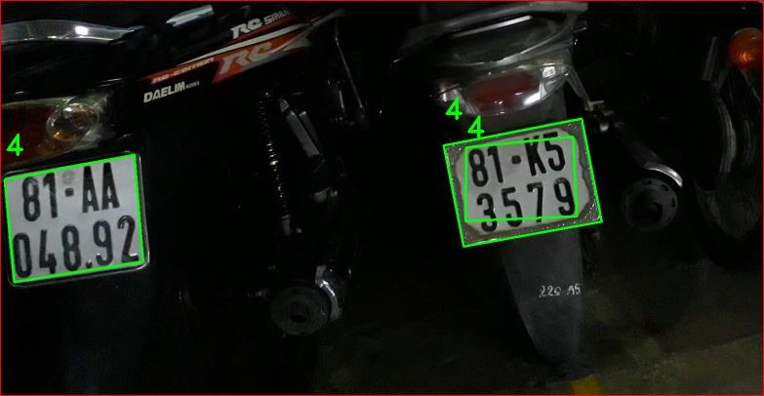
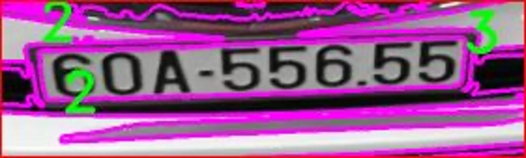
Incorrect plate extraction

Slide 25
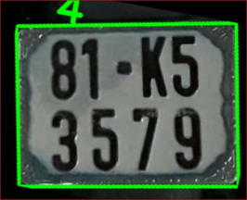
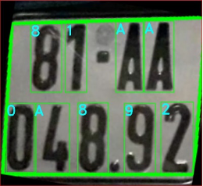
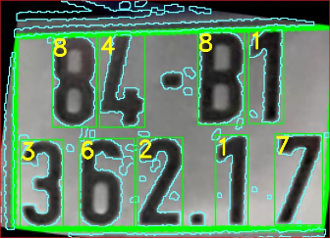
Issues with character recognition
Does not find character
Incorrect recognition: A and 4
Incorrect recognition: B and 8

Slide 26
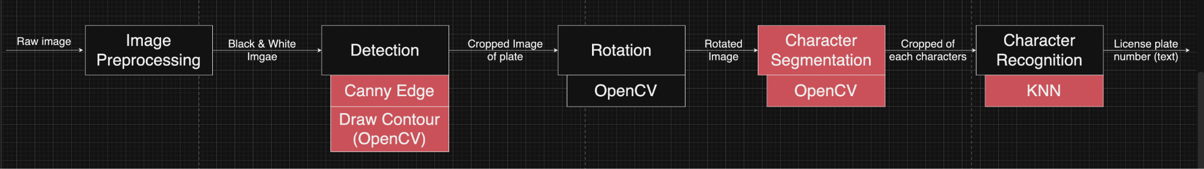
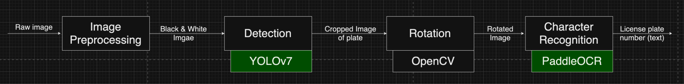
IMPROVEMENTS

Slide 27
Upgrading the license plate recognition technology
Initially, our technology used a custom plate recognition technology, the accuracy of prediction of that model is pretty bad because some cases it couldn’t recognize the license plates so we came up with an idea to upgrade it. After researched for a while, we finally agreed to use YOLO version 7 to detect the license plate better. We use the dataset to train from Kaggle in order to improve the ability to recognize Vietnamese’s license plates. It sometimes can’t detect a license plate if it is so far Away or it’s blurred by reflection.

Slide 28
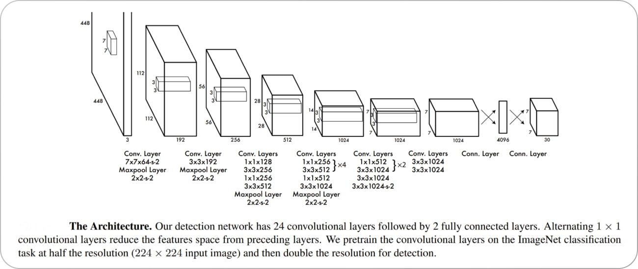
Upgrading plate detection - Yolo version 7
The YOLO algorithm runs on a single deep convolutional neural network of 26 layers:
First 20 convolution layers of the model are pre-trained using ImageNet by plugging in a temporary average pooling and fully connected layer.
Then, this pre-trained model is converted to perform detection
2 final fully connected layer predicts both class probabilities and bounding box coordinates.

Slide 29
Yolo version 7
Why:
Need it to be fast:
Most plate detection and recognition are done with vehicles that need to move on quickly, so it is crucial that the detection happens quickly to save time. YOLO7 is a single stage object detection method so it is appropriate
Doesn’t affect accuracy:
Even though it is less accurate, but the characters on a plate can only have 30 - 40 classes, so it is not very complex, therefore the accuracy won’t be affected as much as when detecting people.

Slide 30
Upgrading the character recognition
Initially, this project uses a custom KNN model in order to recognize the characters on the plates. The accuracy of this project isn’t great as some clearly plates weren’t get recognized. We knew we must come up with another solution. After researched the technology available for a while, we finally agreed to change from the custom KNN model to Paddle Ocr in order to segmentation those characters after the images are processed. The accuracy is much higher than we expected as It can recognize most license plates with an accuracy of more than 90%. Sometimes it wrongly recognizes between the character “0” and “D”. Segmentation is now included in Paddle Ocr.

Slide 31
Paddle Ocr
PaddleOCR, developed by Baidu's PaddlePaddle platform, is an efficient Optical Character Recognition (OCR) system. It uses deep learning for accurate text detection and recognition. The system has a two-stage pipeline: text detection with a Differentiable Binarization (DB) algorithm and text recognition with a CRNN (Convolutional Recurrent Neural Network). PaddleOCR supports multiple languages, uses data augmentation for robustness, and is optimized for both cloud and edge deployment, making it ideal for applications like document scanning, license plate recognition, and scene text extraction.

Slide 32
Paddle Ocr
Paddle OCR follows CRNN Architecture(Convolutional Recurrent Neural Network), consist of three layers:
The first layer is the convolutional neural network (CNN) which consists of Convolutional and max-pooling layers. These are responsible for extracting features from the input images and producing feature maps of vectors as outputs.
The second layer is the Recurrent Neural Network (RNN) which is built on top of the Convolutional Neural Network. It predict the label for each feature vector or frame in the feature sequence received from CNN layers. Mathematically, the layers predict label y for each frame x in feature sequence x = x1,…..,xt.
Transcription layer: This layer is responsible for translating the per-frame predictions into a final sequence according to the highest probability.

Slide 33
Why Paddle OCR > VietOCR
Model | VietOcr | Paddle Ocr
Dataset | Using more hand-written and documentation data to train | Using more street images to train
Language support | Vietnamese only | Supports multiple languages
Features | Optimized for Vietnamese text | Optimized for more versatile choice of language
Ease of use | Easier to use | Harder to use
Performance and accuracy | High performance on Vietnamese text | High performance on multiple language text

Slide 34
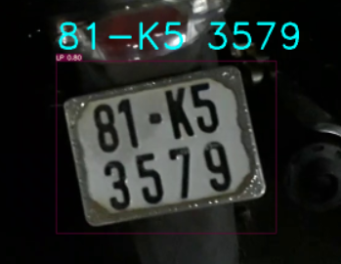
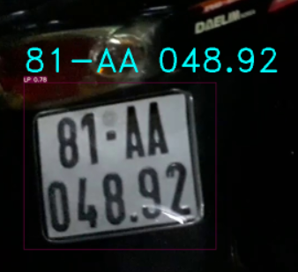
Demo of improvement

Slide 35
References
Marzuki, P. & Radzi, Feeza & Wong, Yan Chiew & Abdul Hamid, Norihan & Ali, Nur & Mat ibrahim, Masrullizam. (2019). A design of license plate recognition system using convolutional neural network. International Journal of Electrical and Computer Engineering (IJECE). 9. 2196. 10.11591/ijece.v9i3.pp2196-2204.
https://www.v7labs.com/blog/yolo-object-detection
https://aurigait.com/blog/how-does-paddle-ocr-reads-image-data/

